Slide 1
Curious Kid
NFT as a collectible

Slide 2
What it Does
Allow users to mint their very own Curious Kid via <TODO add website>
Guarantees NFT uniqueness
Stable earnings for creators
Great as a gift to kids and encourage them to learn about blockchain

Slide 3
How it Works
Image layer/attribute creation - by artist
Final images generated from layers - via powerset method
Images and metadata are uploaded to nft.storage - get CID
Curious Kid contract is deployed (with CID) and users can interact with it via the DAPP website
Curious users can mint their very own Curious Kid 🎉🎉
(randomly via VRF)

Slide 4
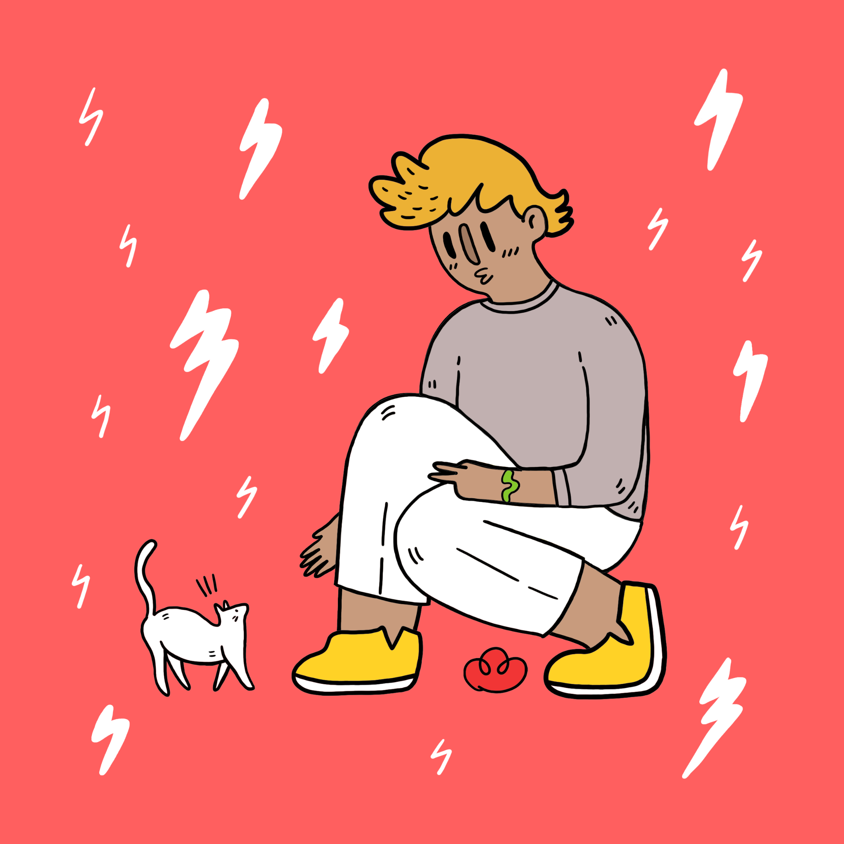
Demo DAPP

Slide 5
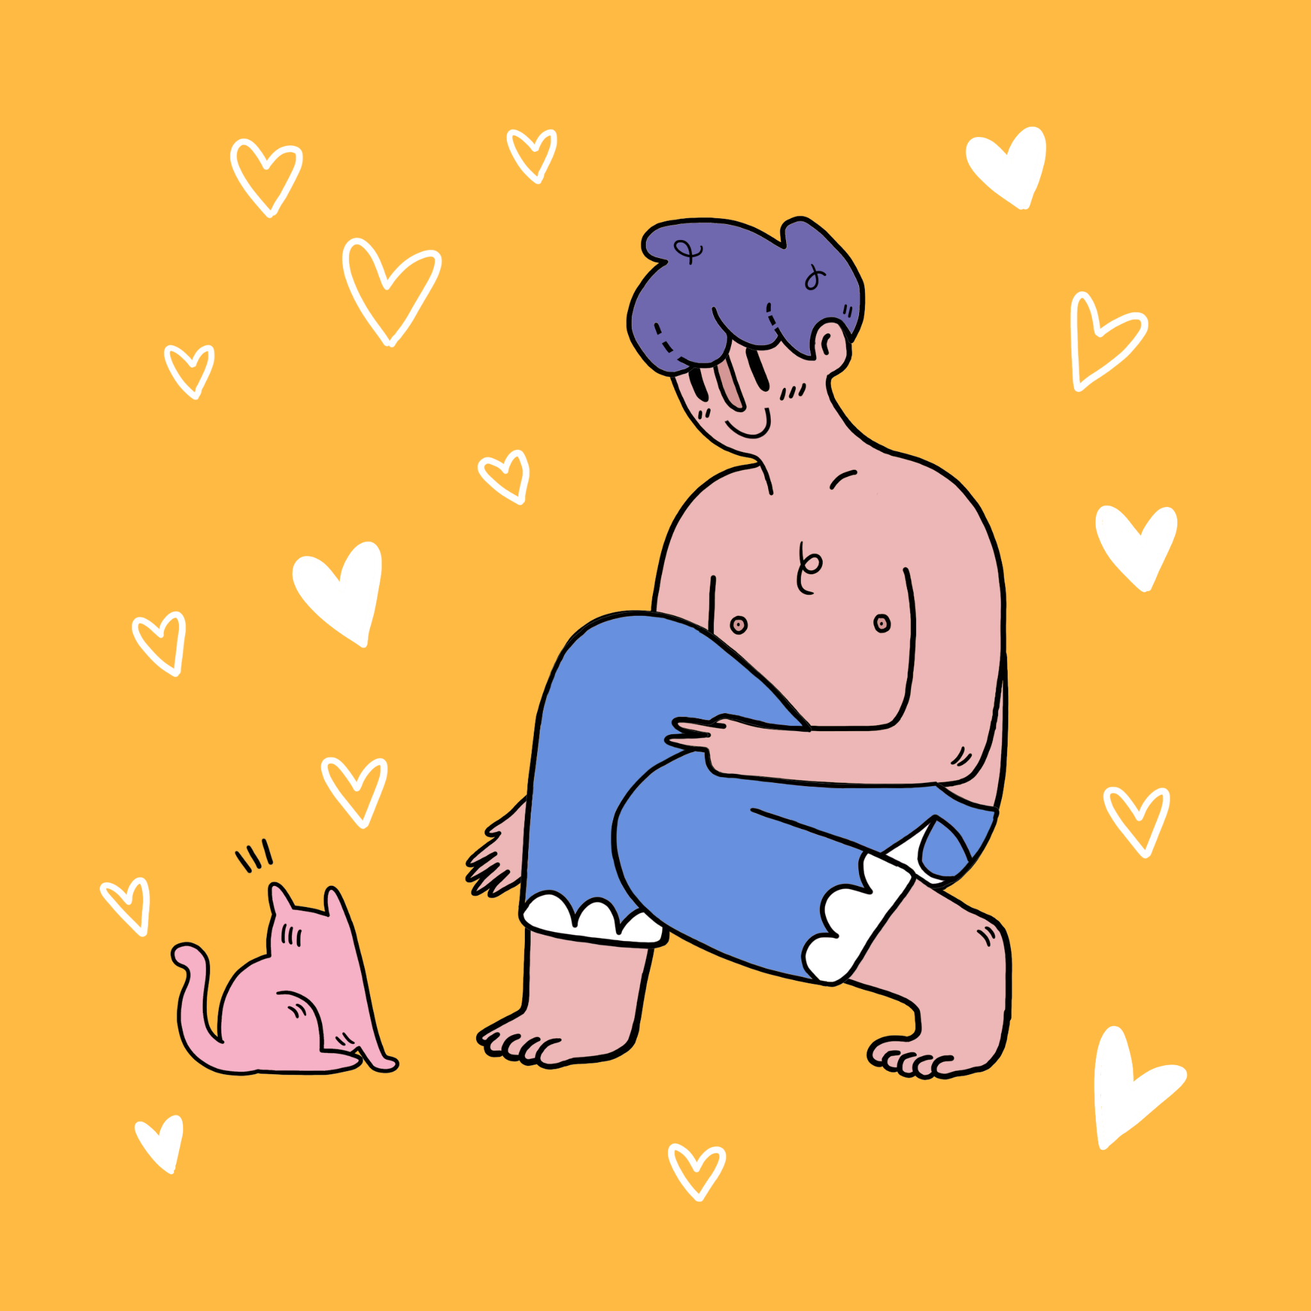
How is it Different?

Slide 6
Mathematically Guaranteed Uniqueness
When random component generation for NFT’s attributes are required:
Most projects
Curious Kid
attr1 = randomNumber % 10000
Powerset
Possibility of duplicate number being generated
No duplicate

Slide 7
Powerset (mathematical concept)
Given {1,2,3} is in set S
{(), (1,), (2,), (3,), (1,2), (1,3), (2,3), (1,2,3)} are all subsets of S
Which is all the possible unique attribute combinations
More info: https://www.mathsisfun.com/sets/power-set.html

Slide 8
2. Sets Token URI On-Chain
Metadata is pre-generated
000.json/000.png
001.json/001.png
Total supply is 128
How do we ensure the random number generated on-chain via VRF has not already been mint?
Method 1
Loop until new random number != old random number
Method 2
Remove number from “deck of cards” without replacement
Uses a lot of gas!! Very expensive!!
This is achieved using totalTokensRemaining, mapIndexToTokenId, _getTokenIdAtIndex, and _adjMapIndexToTokenId in Curious Kid contract

Slide 9
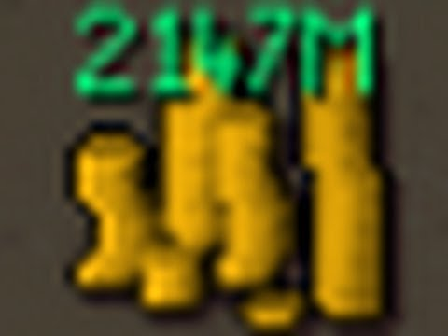
3. EIP-2981 Royalty Standard
Curious Kid implements the EIP-2981 Royalty Standard that allows for marketplaces to implement on-chain royalty
Allows artist and developers to earn their fair share each time a sale on their NFT occurs - backed by the power of decentralization

Slide 10

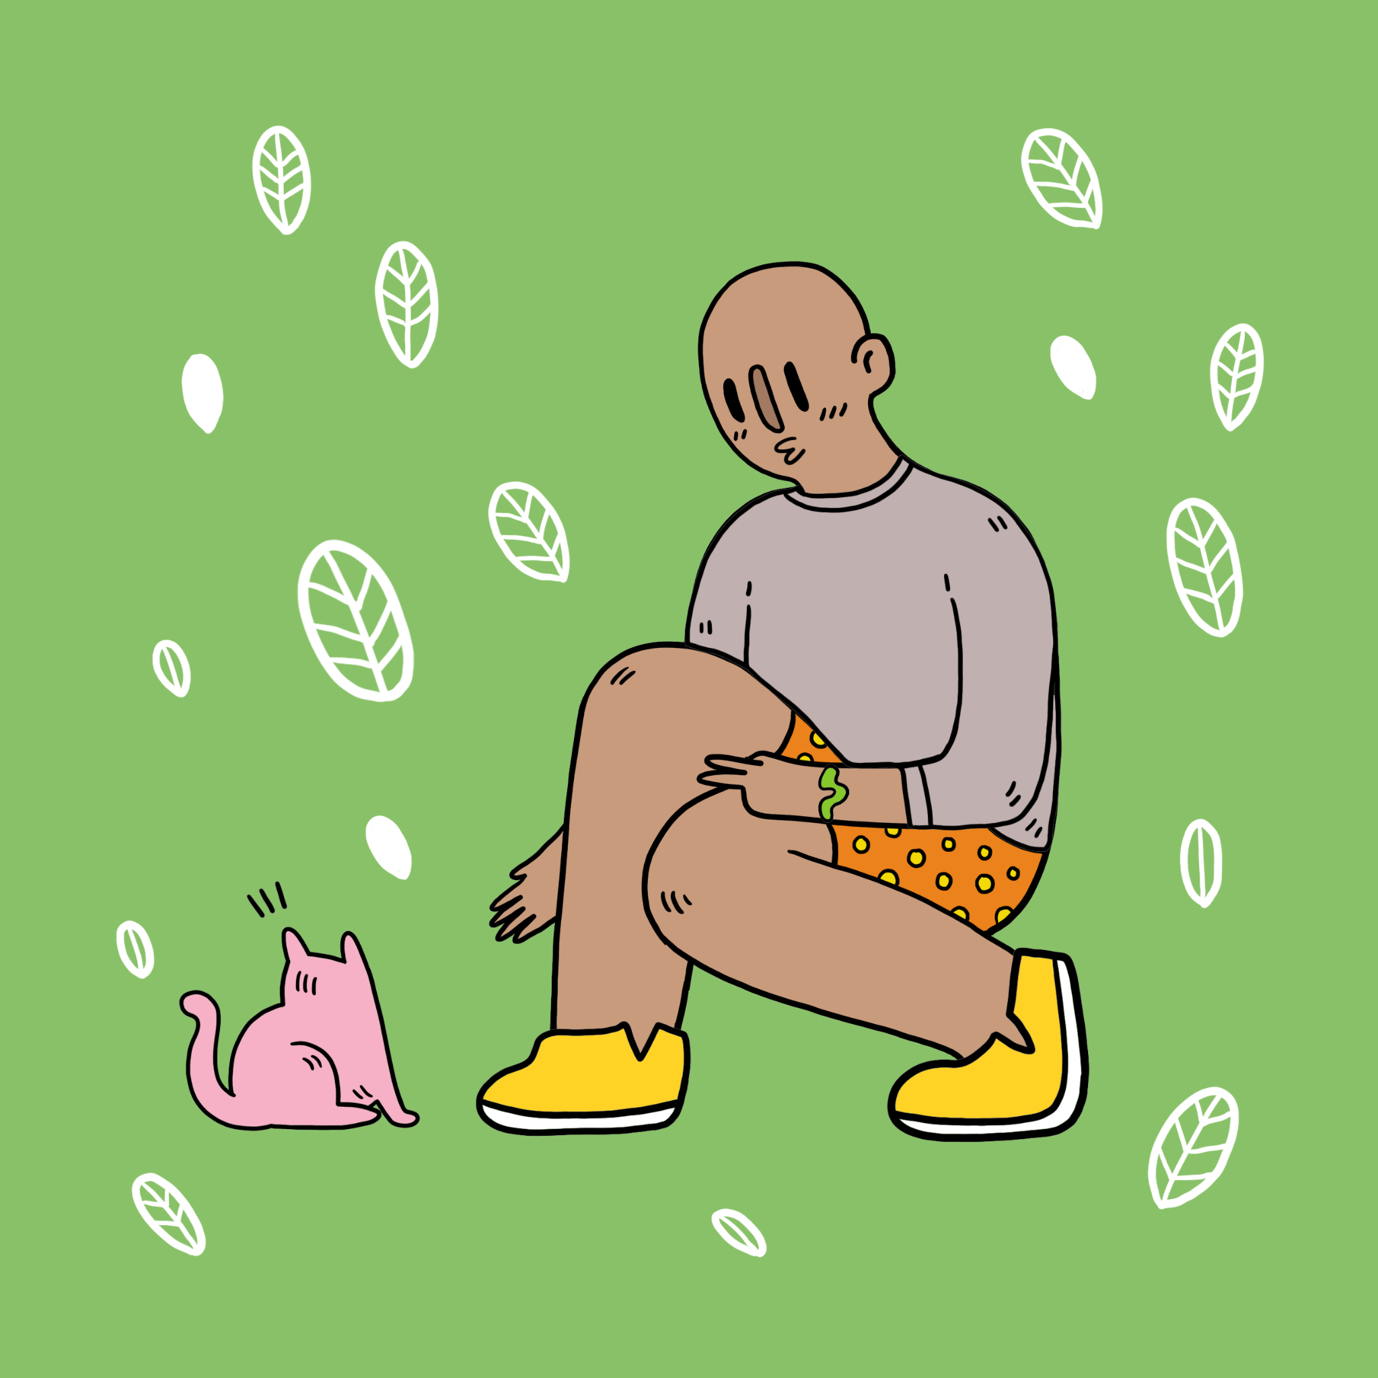
4. Mystery and Excitement
Curious Kid owners can optionally hide the NFT images even after mint and reveal it after awhile, to create some fun and excitement around the minting process - perfect for kids
hideURI()
revealURI()

Slide 11
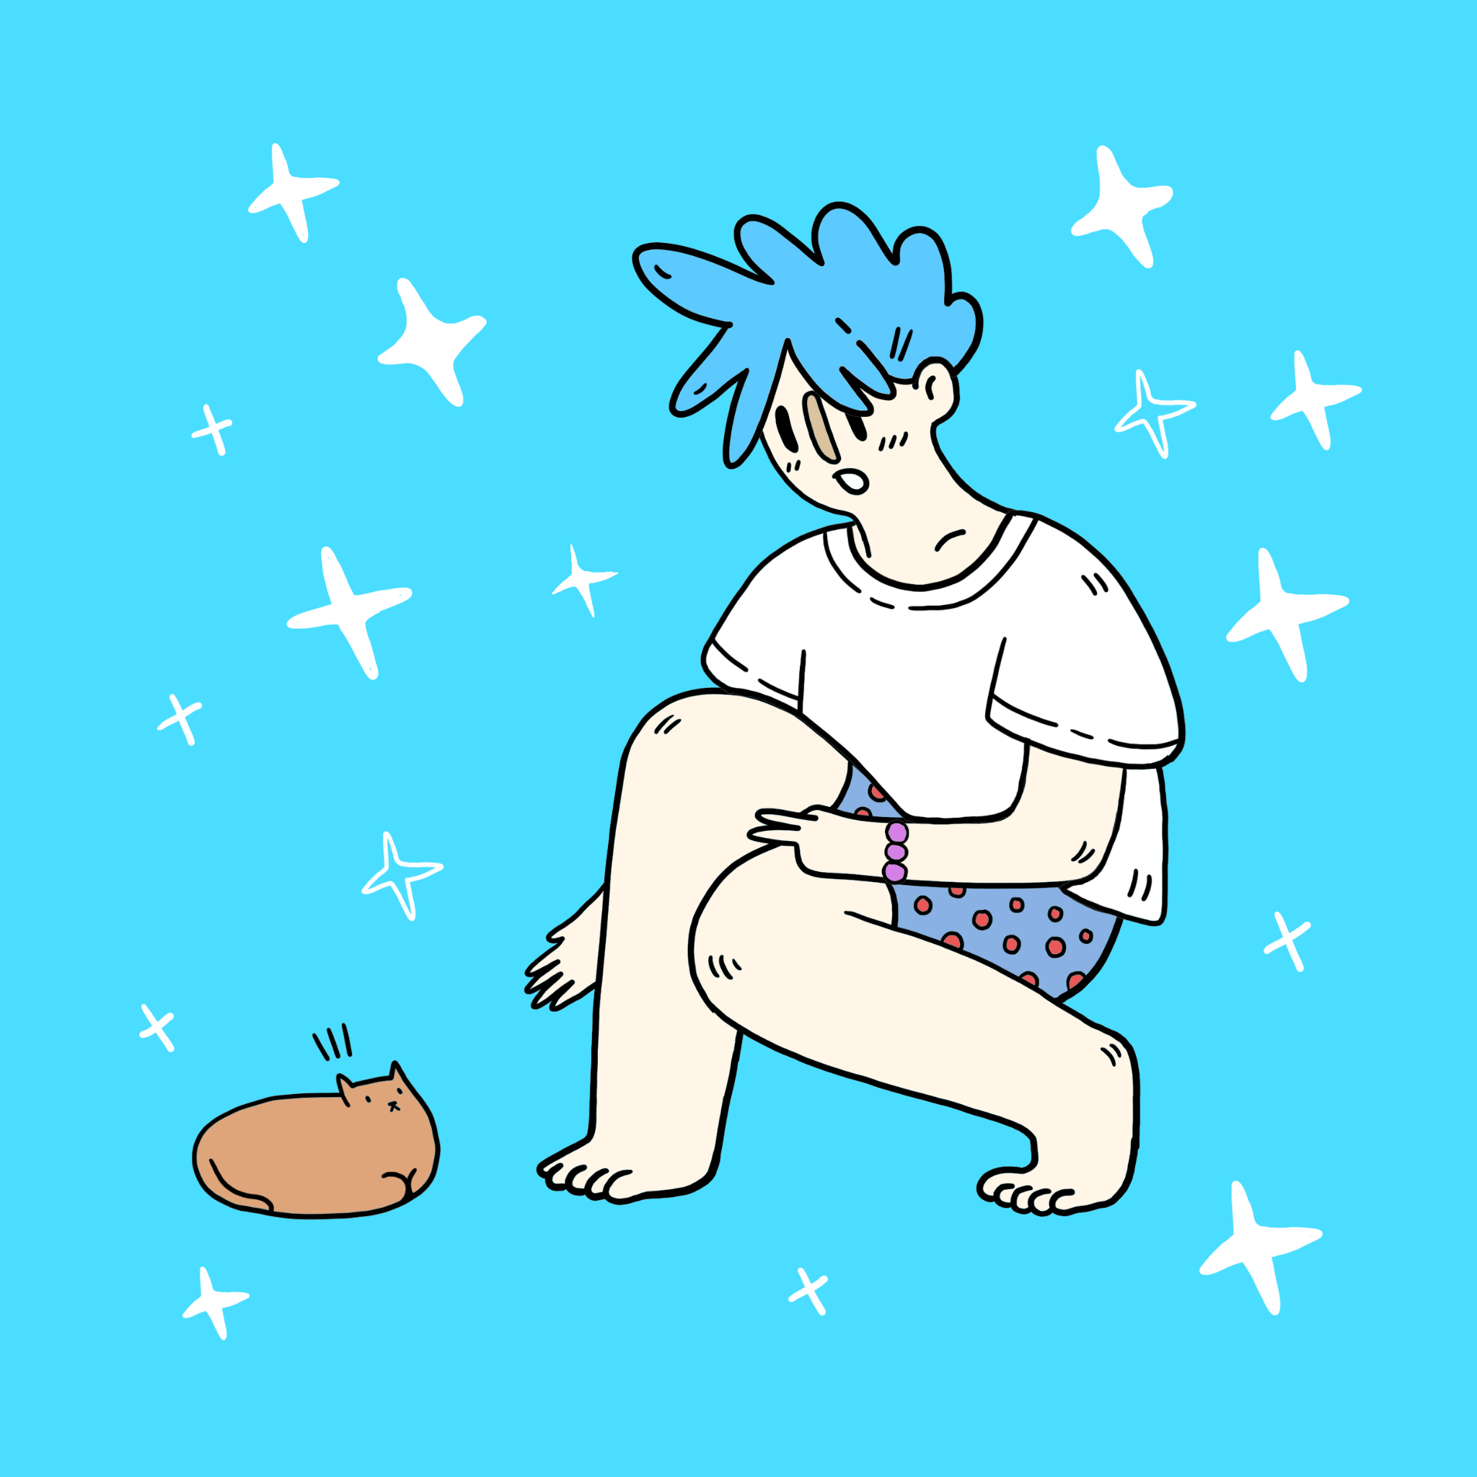
Thanks For Listening

